Slide 1


LIBRARY MANAGEMENT
-KUMKUM upretI
-bhAVINI SHAH

Slide 2
LIBRARY MANAGEMENT
A library management system keeps track of the books present in the library. It is an important piece of software which is must at schools and colleges. We will build a library management system using Tkinter to make it interactive.

Slide 3
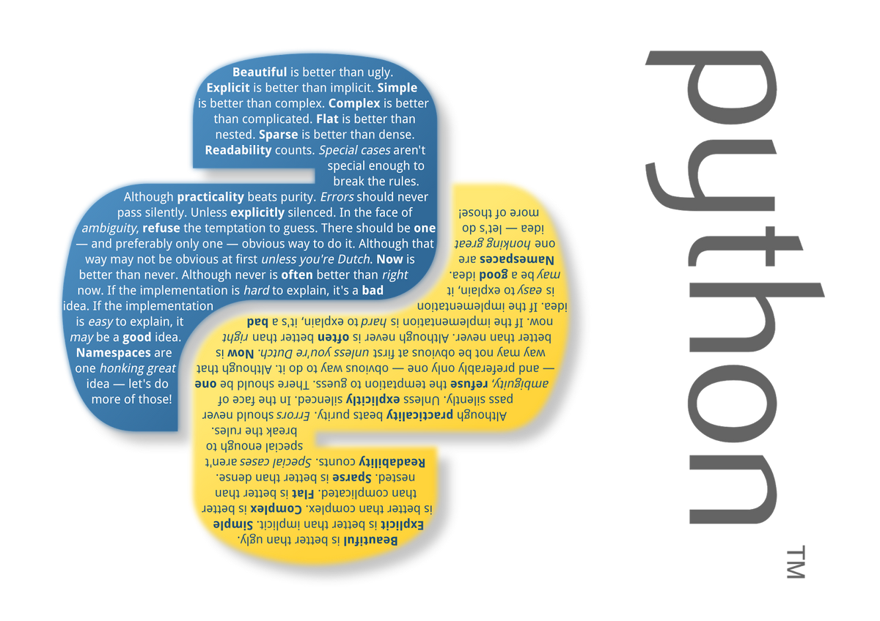
LANGUAGE USED
PYTHON:
Python is a high-level, general-purpose programming language. Its design philosophy emphasizes code readability with the use of significant indentation. Python is dynamically-typed and garbage-collected. It supports multiple programming paradigms.

Slide 4
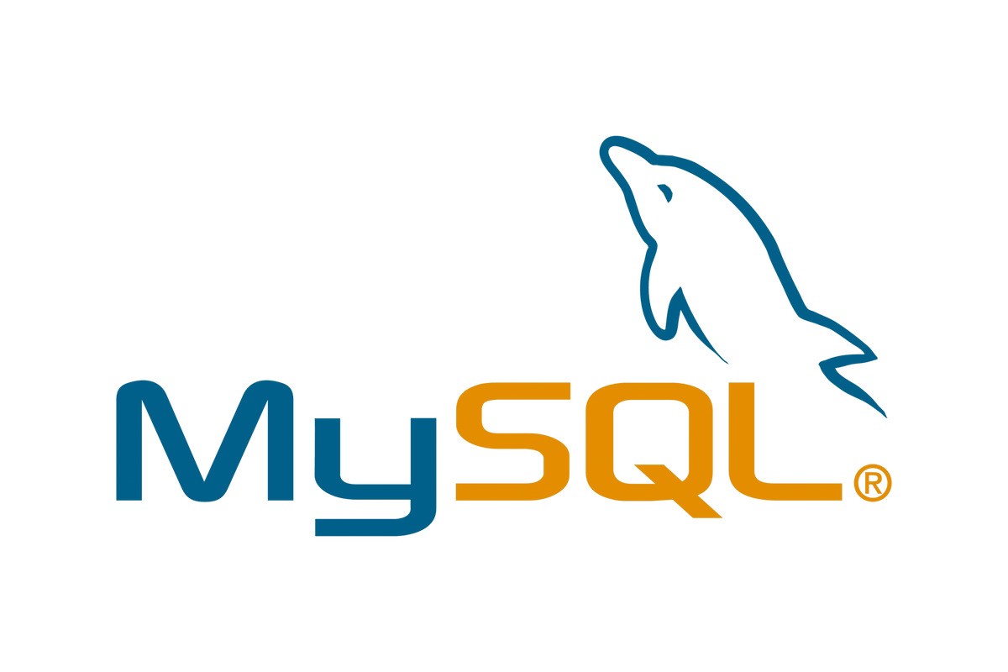
DATABASE USED
MYSQL:
MySQL is an open-source relational database management system (RDBMS).Its name is a combination of "My", the name of co-founder Michael Widenius's daughter My, and "SQL", the acronym for Structured Query Language. A relational database organizes data into one or more data tables in which data may be related to each other; these relations help structure the data. SQL is a language programmers use to create, modify and extract data from the relational database, as well as control user access to the database. In addition to relational databases and SQL, an RDBMS like MySQL works with an operating system to implement a relational database in a computer's storage system, manages users, allows for network access and facilitates testing database integrity and creation of backups.

Slide 5
LIBRARIES USED
TKINTER : For Creating GUI.
PILLOW : For Background Image Processing.
PYMYSQL : For connection between python program and MySQL database.

Slide 6
WHAT IS TKINTER
A library management system keeps track of the books present in the library. It is an important piece of software which is a must at schools and colleges. We will build a library management system using Tkinter to make it interactive.

Slide 7
FEATURES
Decent looking UI
Systematic Code structure by dividing parts in different files
Use of Relational database MySQL for storing data
Several Real-World inspired options like add new book, delete, issue a book to someone, return that book etc.

Slide 8
PROJECT FILES OUTLOOK
Below are the project files…
main.py – which does function call to all other python files
AddBook.py – To add the book
ViewBooks.py – To View the list of books in the library
DeleteBook.py – To Delete a book from library
IssueBook.py – To Issue a book from library
ReturnBook.py – To Return a book to the library

Slide 9
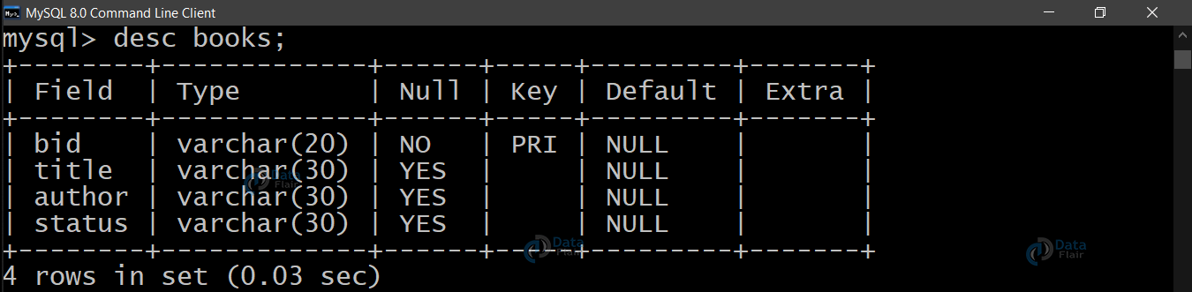
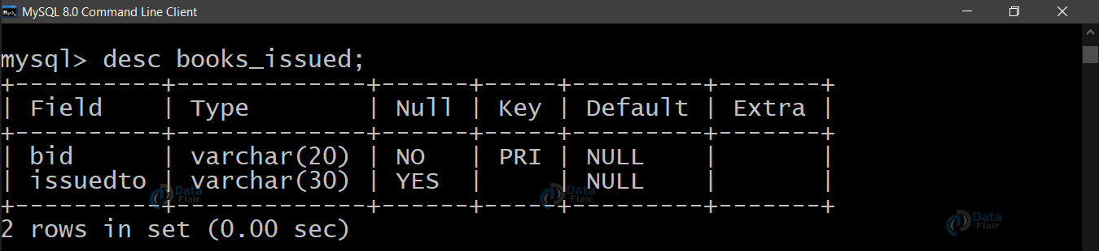
DATABASE TABLES DESCRIPTION
BOOKS
ISSUED_BOOKS

Slide 10
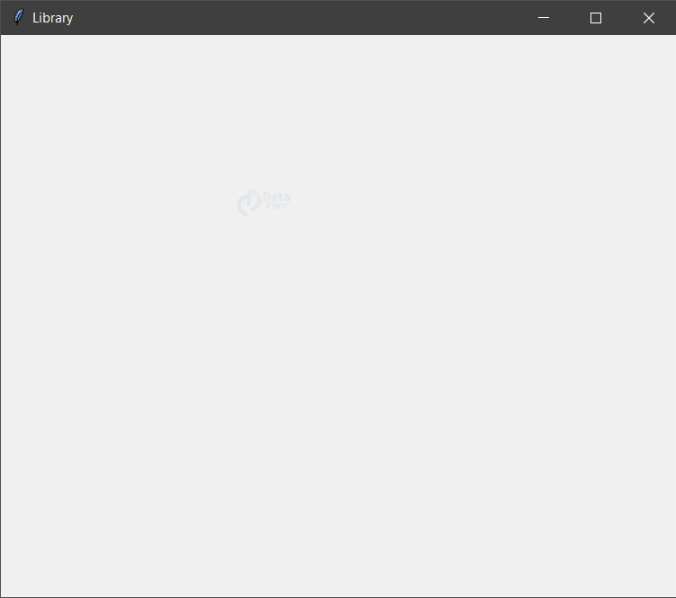
CODE EXPLAINATION
1) main.py
1.1. Importing the Modules
1.2. Connecting to the MySql server
mypass = "root" #use your own password
mydatabase="db" #The database name
con = pymysql.connect (host="localhost",user="root",password=mypass,database=mydatabase)
cur = con.cursor()
1.3. Designing the Window
root = Tk()
root.title("Library")
root.minsize(width=400,height=400)
root.geometry("600x500")
Output:

Slide 11
CODE EXPLAINATION
1) main.py
1.4. Adding a Background Image
We store our image in background_image with the help of .open() method. We fetch the image dimensions and adjust the image size according to our window size.
newImageHeight and newImageWidth contains the adjusted image dimensions.
Now we resize the image using .resize() method using the new dimensions.
The .PhotoImage() method is used to display images (either grayscale or true color images) in labels, buttons, canvases, and text widgets.
We create the image on the canvas1 using .create_image() method. We use .pack() method to organize widgets in blocks before placing them in the parent widget.
1.5. Setting up the Head Frame
We create a frame that will hold our Label wiz headingLabel. We increase the size and alter the font by passing one more parameter in the Label method wiz font.

Slide 12
CODE EXPLAINATION
1) main.py
1.6. Adding the Buttons
btn1 = Button(root,text="Add Book Details",bg='black', fg='white', command=addBook)
btn1.place(relx=0.28,rely=0.4, relwidth=0.45,relheight=0.1)
btn2 = Button(root,text="Delete Book",bg='black', fg='white', command=delete)
btn2.place(relx=0.28,rely=0.5, relwidth=0.45,relheight=0.1) btn3 = Button(root,text="View Book List",bg='black', fg='white', command=View)
btn3.place(relx=0.28,rely=0.6, relwidth=0.45,relheight=0.1) btn4 = Button(root,text="Issue Book to Student",bg='black', fg='white', command = issueBook)
btn4.place(relx=0.28,rely=0.7, relwidth=0.45,relheight=0.1) btn5 = Button(root,text="Return Book",bg='black', fg='white', command = returnBook) root.mainloop()
AddBook Details :
btn1 stores the button created on root with text = ‘AddBook Details’. As soon as someone clicks this button, we call the function addBook defined in the AddBook.py. We call a function by specifying the command parameter equal to the name of the function.
We place this button using the .place() method by defining the position as well as dimensions of the button.
Similarly, we define other buttons using the Button method and keep placing them by making minor changes in the rely parameter. You can notice that we are increasing it by 0.1 every time we define a new button.

Slide 13
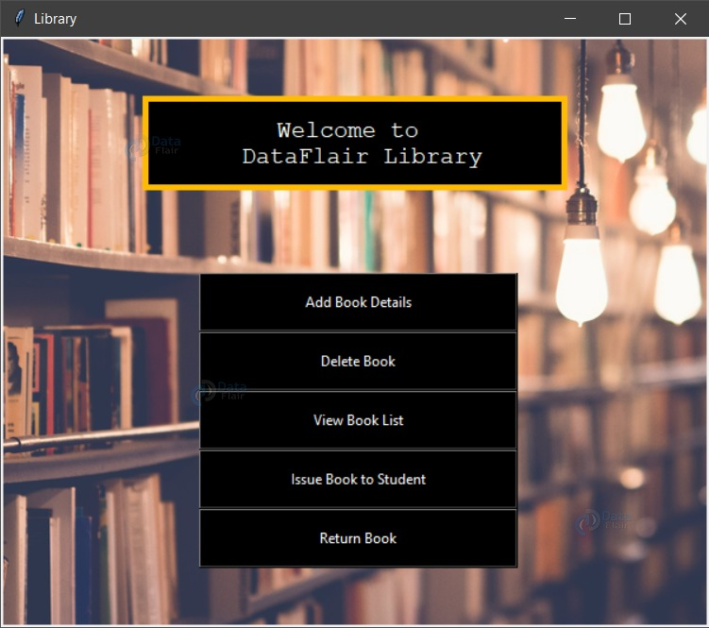
RESULTS:

Slide 14
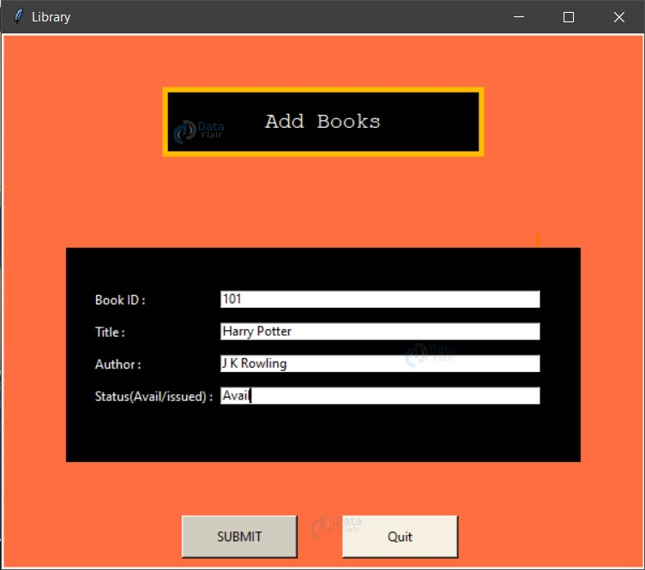
RESULTS:

Slide 15
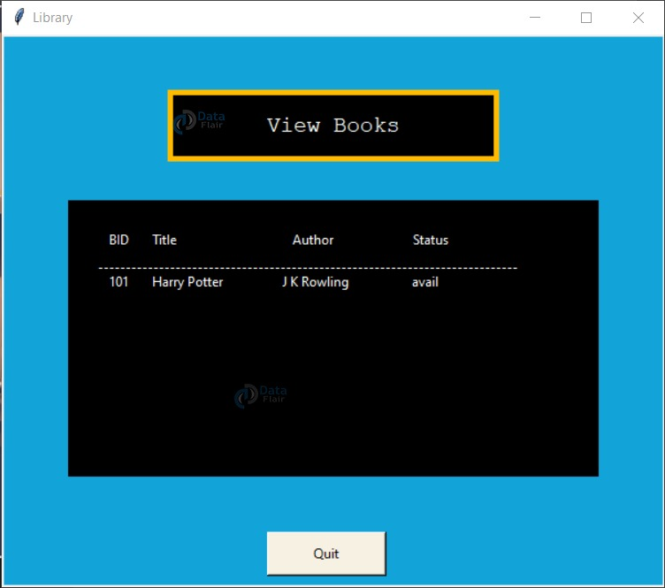
RESULTS:

Slide 16
SUMMARY
We have successfully designed a Library management system using python and tkinter with a decent UI. In order to make things easy, this tutorial divided the various tasks into different python files. In the real world, we follow such practices to make things easy to build. Hence, whenever making a project, divide your goals into modules and integrate them at a later stage.

Slide 17

Thank You!

